Slide 1
HNDIT1022 – Web Design
Week 8, 9 & 10:
understanding JavaScript Programming

Slide 2
Subtopics
What is scripting
How scripting and programming are different
How to include java script commands into web page Functions and build in functions
How objects use in java scripts Responding to events
Conditional statements and looping
Syntax rules avoid errors
Adding comments

Slide 3
Contd…
Name and declare variables
Assign variable
Use variables and literal expressions
Create arrays of numbers and strings
How event handlers related to objects
Create new window with java script
How to build frameset
Link between frames and windows
Use JavaScript to work with frames

Slide 4
What is scripting?
As the name suggest, it’s all about giving the script to perform some certain task.
Scripting languages are basically the subcategory of programming languages which is used to give guidance to another program or we can say to control another program, so it also involves instructions.
It basically connects one language to one another languages and doesn’t work standalone.
Scripting languages need to be interpreted (Scanning the code line by line, not like compiler in one go) instead of compiled.

Slide 5
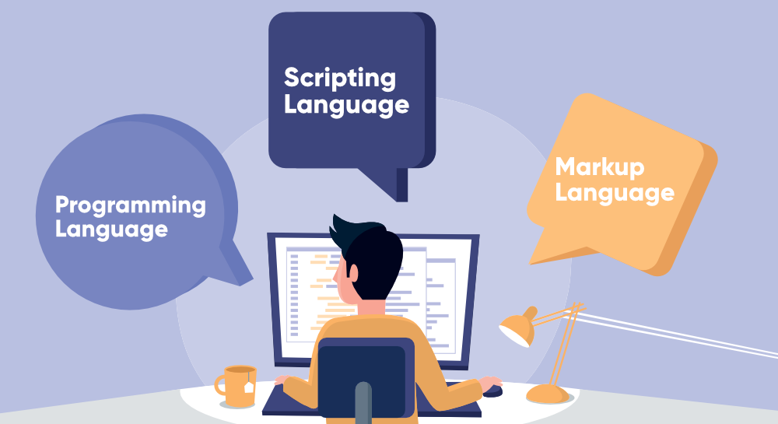
Contd…
When it comes to making a website or application coding involves basically three types of languages i.e the programming language, Scripting Language and Markup Language.

Slide 6
Programming VS Scripting
A programming language is a computer language that is used to communicate with computers using a set of instructions. | A scripting language is a type of programming language designed for a runtime system to automate the execution of tasks.
It is compiled language or compiler-based language. | It is interpreted language or interpreter-based language
It is used to develop an application or software from scratch. | It is used to combine existing components and automate a specific task.
It runs or executes independently and does not depend on the parent (exterior) program. | It runs or executes inside another program.
It uses a compiler to convert source code into machine code. | It uses an interpreter to convert source code into machine code.
As it uses a compiler, hence the complete program is converted into machine code in one shot. | As it uses an interpreter, hence the program is converted into machine code line by line.
These languages are required to be compiled. | There is no need for compilation.
It is comparatively difficult to write code in a programming language, and it requires numerous lines of code for each task. | It is comparatively easy to write code in the scripting language, and it requires few lines of code for each task.
The development time in programming languages is high as more lines are required. | The development time in a scripting language as a smaller number of lines are required.
There is the high maintenance cost. | There is less maintenance cost.
All programming languages are not scripting languages | All scripting languages are programming languages
It generates a .exe file. | It does not create a .exe file.
Usually, programming languages do not support or provide very little support for user interface designing, data types, and graphic designing. | Scripting languages provide great support to user interface design, data types, and graphic design.
Some popular examples are C, C++, Java, Scala, COBOL, etc. | Some popular examples are Perl, Python, JavaScript, etc.

Slide 7
Characteristics of Client-side Scripting
Client-side scripts can modify the pages at runtime, and therefore, they also falls under the heading of DHTML (dynamic HTML).
Client-side scripts have greater access to the information and functions available on the user's computer, whereas for server-side scripts its for the server.
Client-side scripts require that the user's web browser understand the scripting language in which they are written.

Slide 8
Some Uses of Client-side Scripting
Form verification
Client-side scripts can parse form data prior to the data being submitted to a handler on the server, ensuring that there are no obvious errors (missing or improperly formatted data).
Document animation and automation
Accessing element data and properties via the DOM, client-side scripts can affect changes in elements’ content, appearance, size, position, and so forth.
Basic document intelligence
Client-side scripts can embed a base level of intelligence to the document by linking elements to scripts via events (mouse clicks, key presses, and so on).
Notes:
Document object model

Slide 9
Client-side Scripting Languages
JavaScript
JScript
VBScript
ActionScript
AJAX

Slide 10
JAVA SCRIPT Introduction
JavaScript is a object-based scripting language and it is light weighted.
It is first implemented by Netscape (with help from Sun Microsystems).
JavaScript was created by Brendan Eich at Netscape in 1995 for the purpose of allowing code in web-pages (performing logical operation on client side).
It is not compiled but translated. JavaScript Translator is responsible to translate the JavaScript code which is embedded in browser.

Slide 11
Where it is used?
It is used to create interactive websites.
It is mainly used for:
Client-side validation
Dynamic drop-down menus
Displaying date and time
Build small but complete client side programs .
Displaying popup windows and dialog boxes (like alert dialog box, confirm dialog box and prompt dialog box)
Displaying clocks etc.

Slide 12
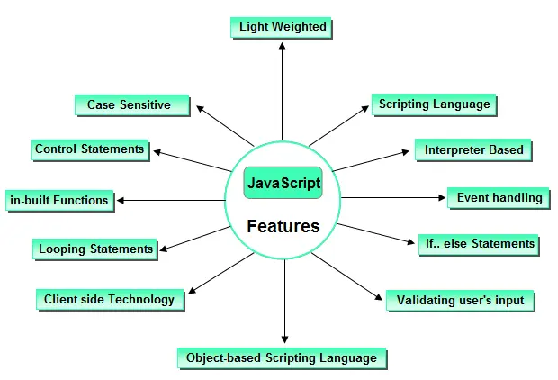
Features of JavaScript JavaScript is a client side technology, it is mainly used for gives client side validation, but it have lot of features which are given below;

Slide 13
Way of Using JavaScript
There are three places to put the JavaScript code.
Between the <body> </body> tag of html (Inline JavaScript)
Between the <head> </head> tag of html (Internal JavaScript)
In .js file (External JavaScript)

Slide 14
How to Put a JavaScript Into an HTML Page?
<html>
<body>
<script type="text/javascript">
document.write("Hello World!")
</script>
</body>
</html>

Slide 15
Inline JavaScript
When java script was written within the html element using attributes related to events of the element then it is called as inline java script.
Example of Inline JavaScript
Example How to use JavaScript
<html> <form> <input type="button" value="Click" onclick="alert('Button Clicked')"/> </form> </html>
Output:
Click

Slide 16
Internal JavaScript
When java script was written within the section using element then it is called as internal java script.
Example of Internal JavaScript
<html>
<head>
<script>
function msg()
{ alert("Welcome in JavaScript"); }
</script>
</head>
<form>
<input type="button" value="Click" onclick="msg()"/>
</form>
</html>
Output:
click

Slide 17
External JavaScript
Writing java script in a separate file with extension .js is called as external java script. For adding the reference of an external java script file to your html page, use tag with src attribute as follows
Example
<script type="text/javascript" src="filename.js"/>
Create a file with name functions.js and write the following java script functions in it.
message.js
Example
function msg() { alert("Welcome in JavaScript"); }

Slide 18
Example
<html>
<head>
<script type="text/javascript" src="message.js">
</script>
</head>
<body>
<form>
<input type="button" value="click" onclick="msg()"/>
</form>
</body>
</html>
output:
click

Slide 19
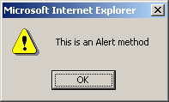
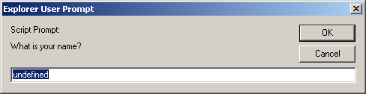
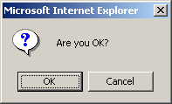
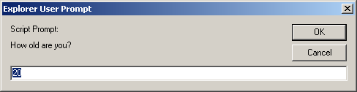
alert(), confirm(), and prompt()
<script type="text/javascript">
alert("This is an Alert method");
confirm("Are you OK?");
prompt("What is your name?");
prompt("How old are you?","20");
</script>

Slide 20
alert() and confirm()
alert("Text to be displayed");
Display a message in a dialog box.
The dialog box will block the browser.
var answer = confirm("Are you sure?");
Display a message in a dialog box with two buttons: "OK" or "Cancel".
confirm() returns true if the user click "OK". Otherwise it returns false.

Slide 21
prompt()
prompt("What is your student id number?");
prompt("What is your name?”, "No name");
Display a message and allow the user to enter a value
The second argument is the "default value" to be displayed in the input textfield.
Without the default value, "undefined" is shown in the input textfield.
If the user click the "OK" button, prompt() returns the value in the input textfield as a string.
If the user click the "Cancel" button, prompt() returns null.

Slide 22
Identifier
Same as Java/C++ except that it allows an additional character – '$'.
Contains only 'A' – 'Z', 'a' – 'z', '0' – '9', '_', '$'
First character cannot be a digit
Case-sensitive
Cannot be reserved words or keywords

Slide 23
Variable and Variable Declaration
<head><script type="text/javascript">
// We are in the default scope – the "window" object.
x = 3; // same as "window.x = 3"
var y = 4; // same as "y = 4" or "window.y = 4"
{ // Introduce a block to creat a local scope
x = 0; // Same as "window.x = 0"
var y = 1; // This is a local variable y
}
alert("x=" + x + ", y=" + y); // Print x=0, y=4
</script></head>
Local variable is declared using the keyword 'var'.
Dynamic binding – a variable can hold any type of value
If a variable is used without being declared, the variable is created automatically.
If you misspell a variable name, program will still run (but works incorrectly)

Slide 24
Data Types
Primitive data types
Number: integer & floating-point numbers
Boolean: true or false
String: a sequence of alphanumeric characters
Composite data types (or Complex data types)
Object: a named collection of data
Array: a sequence of values (an array is actually a predefined object)
Special data types
Null: the only value is "null" – to represent nothing.
Undefined: the only value is "undefined" – to represent the value of an unintialized variable

Slide 25
Strings
A string variable can store a sequence of alphanumeric characters, spaces and special characters.
Each character is represented using 16 bit
You can store Chinese characters in a string.
A string can be enclosed by a pair of single quotes (') or double quote (").
Use escaped character sequence to represent special character (e.g.: \", \n, \t)

Slide 26
typeof operator
var x = "hello", y;
alert("Variable x value is " + typeof x );
alert("Variable y value is " + typeof y );
alert("Variable x value is " + typeof z );
An unary operator that tells the type of its operand.
Returns a string which can be "number", "string", "boolean", "object", "function", "undefined", and "null"
An array is internally represented as an object.

Slide 27
Operators
Arithmetic operators
+, -, *, /, %
Post/pre increment/decrement
++, --
Comparison operators
==, !=, >, >=, <, <=
===, !== (Strictly equals and strictly not equals)
i.e., Type and value of operand must match / must not match

Slide 28
== vs ===
// Type conversion is performed before comparison
var v1 = ("5" == 5); // true
// No implicit type conversion.
// True if only if both types and values are equal
var v2 = ("5" === 5); // false
var v3 = (5 === 5.0); // true
var v4 = (true == 1); // true (true is converted to 1)
var v5 = (true == 2); // false (true is converted to 1)
var v6 = (true == "1") // true

Slide 29
Logical Operators
! – Logical NOT
&& – Logical AND
OP1 && OP2
If OP1 is true, expression evaluates to the value of OP2.
Otherwise the expression evaluates to the value of OP1.
Results may not be a boolean value.
|| – Logical OR
OP1 || OP2
If OP1 is true, expression evaluates to the value of OP1. Otherwise the expression evaluates to the value of OP2.

Slide 30
var tmp1 = null && 1000; // tmp1 is null
var tmp2 = 1000 && 500; // tmp2 is 500
var tmp3 = false || 500; // tmp3 is 500
var tmp4 = "" || null; // tmp4 is null
var tmp5 = 1000 || false; // tmp5 is 1000
// If foo is null, undefined, false, zero, NaN,
// or an empty string, then set foo to 100.
foo = foo || 100;

Slide 31
Operators Contd …
String concatenation operator
+
If one of the operand is a string, the other operand is automatically converted to its equivalent string value.
Assignment operators
=, +=, -=, *=, /=, %=
Bitwise operators
&, |, ^, >>, <<, >>>

Slide 32
Control Structures
JavaScript supports the following control structures,
If…Else
Switch
Do…While
While
For and For…In

Slide 33
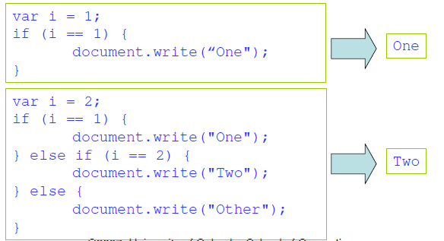
If…Else
The if and if…else constructs execute a block of code depending on the evaluation (true or false) of an expression.
E.g.

Slide 34
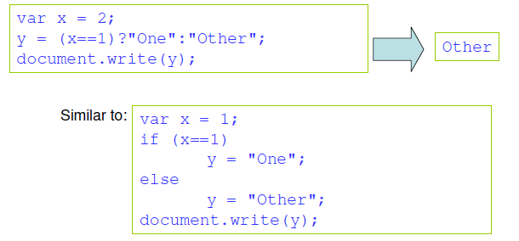
Conditional Operator
JavaScript also contains a conditional operator that assigns a value to a variable based on some condition.
E.g.

Slide 35
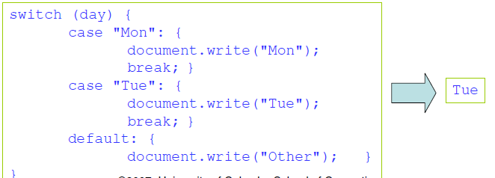
Switch
The switch construct executes specific block(s) of code based on the value of a particular expression.
Note: Use break statement to prevent the code from running into the next case automatically.
E.g.

Slide 36
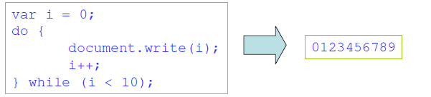
Do…While
The do…while loop executes one or more lines of code as long as a specified condition remains true.
E.g.
Note: Due to the expression being evaluated at the end of the structure, statement(s) in the do…while loop are executed at least once, even if the condition is false.

Slide 37
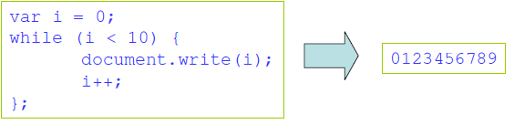
While
The while loop executes one or more lines of code while specified expression remains true.
E.g.
Note: Because the expression is evaluated at the beginning of the loop, the statement(s) will not be executed if the expression is false at the beginning.

Slide 38

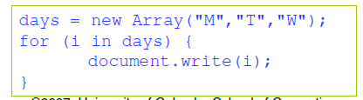
For and For…In
The for loop executes statement(s) a specified number of times governed by two expressions and a condition.
E.g.
The for...in loop executes statement(s) while assigning a variable to the properties of an object or elements of an array.
E.g.

Slide 39
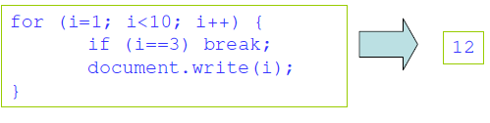
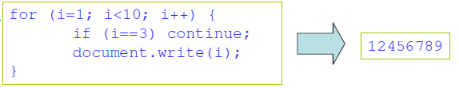
Break and Continue
The break command will break the loop and continue executing the code that follows after the loop (if any).
E.g.
The continue command will break the current loop and continue with the next value.
E.g

Slide 40
Labels
Labels are used to mark statements for reference by other statements in other sections of a script.
Labels can solve the problem of breaking from a loop that is nested inside another loop.
E.g.

Slide 41
Conditional Statements Examples
<script>
x=3
if(x<0)
{
alert (“negative”)
}
else
{
alert (“positive”)
}
</script>

Slide 42
Conditional Statements Examples Contd…
<script>
c=confirm(“Do you read books?”)
if(c)
{
alert (“Good. Keep it up”)
}
else
{
alert (“Shame on you”)
}
</script>

Slide 43
Conditional Statements Examples Contd …
<script>
p=prompt(“Enter your lucky number?", " ")
if(p=="08")
{
alert(“True")
}
else
{
alert(“False")
}
</script>

Slide 44
Functions and Procedures
A function in a JavaScript is a set of statements that performs a specific task (a procedure).
A function will be executed by an event or by a call to that function.
Functions can be defined both in the <head> and in the <body> section of a document. However, to assure that the function is read/loaded by the browser before it is called, it could be wise to put it in the <head> section.
A function can be called from anywhere within the page (or even from other pages if the function is embedded in an external .js file).

Slide 45
Contd…
function name() {
statement ;
statement ;
...
statement ;
} JS
function myFunction() {
alert("Hello!");
alert("How are you?");
} JS
the above could be the contents of example.js linked to our HTML page
statements placed into functions can be evaluated in response to user events

Slide 46
Built-In Functions
eval(expr)
evaluates an expression or statement
eval("3 + 4"); // Returns 7 (Number)
eval("alert('Hello')"); // Calls the function alert('Hello')
isFinite(x)
Determines if a number is finite
isNaN(x)
Determines whether a value is “Not a Number”

Slide 47
Built-In Functions
parseInt(s)
parseInt(s, radix)
Converts string literals to integers
Parses up to any character that is not part of a valid integer
parseInt("3 chances") // returns 3
parseInt(" 5 alive") // returns 5
parseInt("How are you") // returns NaN
parseInt("17", 8) // returns 15
parseFloat(s)
Finds a floating-point value at the beginning of a string.
parseFloat("3e-1 xyz") // returns 0.3
parseFloat("13.5 abc") // returns 13.5

Slide 48
Events
An event occurs as a result of some activity
e.g.:
A user clicks on a link in a page
Page finished loaded
Mouse cursor enter an area
A preset amount of time elapses
A form is being submitted

Slide 49
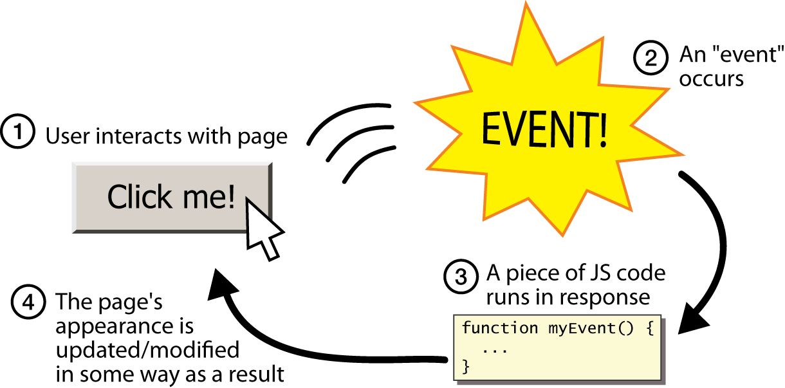
Event-driven programming
split breaks apart a string into an array using a delimiter
can also be used with regular expressions (seen later)
join merges an array into a single string, placing a delimiter between them

Slide 50
Event Handlers
Event Handler – a segment of codes (usually a function) to be executed when an event occurs
We can specify event handlers as attributes in the HTML tags.
The attribute names typically take the form "onXXX" where XXX is the event name.
e.g.:
<a href="…" onClick="alert('Bye')">Other Website</a>

Slide 51
Event Handlers
Event Handlers | Triggered when
onChange | The value of the text field, textarea, or a drop down list is modified
onClick | A link, an image or a form element is clicked once
onDblClick | The element is double-clicked
onMouseDown | The user presses the mouse button
onLoad | A document or an image is loaded
onSubmit | A user submits a form
onReset | The form is reset
onUnLoad | The user closes a document or a frame
onResize | A form is resized by the user
For a complete list, see http://www.w3schools.com/htmldom/dom_obj_event.asp

Slide 52
onClick Event Handler Example
<html>
<head>
<title>onClick Event Handler Example</title>
<script type="text/javascript">
function warnUser() {
return confirm("Are you a student?”);
}
</script>
</head>
<body>
<a href="ref.html" onClick="return warnUser()">
<!--
If onClick event handler returns false, the link
is not followed.
-->
Students access only</a>
</body>
</html>

Slide 53
onLoad Event Handler Example
<html><head>
<title>onLoad and onUnload Event Handler Example</title>
</head>
<body
onLoad="alert('Welcome to this page')"
onUnload="alert('Thanks for visiting this page')"
>
Load and UnLoad event test.
</body>
</html>

Slide 54
onMouseOver & onMouseOut Event Handler
<html>
<head>
<title>onMouseOver / onMouseOut Event Handler Demo</title>
</head>
<body>
<a href="http://www.cuhk.edu.hk"
onMouseOver="window.status='CUHK Home'; return true;"
onMouseOut="status=''"
>CUHK</a>
</body>
</html>
When the mouse cursor is over the link, the browser displays the text "CUHK Home" instead of the URL.
The "return true;" of onMouseOver forces browser not to display the URL.
window.status and window.defaultStatus are disabled in Firefox.

Slide 55
onSubmit Event Handler Example
<html><head>
<title>onSubmit Event Handler Example</title>
<script type="text/javascript">
function validate() {
// If everything is ok, return true
// Otherwise return false
}
</script>
</head>
<body>
<form action="MessageBoard" method="POST"
onSubmit="return validate();"
>
…
</form></body></html>
If onSubmit event handler returns false, data is not submitted.
If onReset event handler returns false, form is not reset

Slide 56
Build-In JavaScript Objects
Object | Description
Array | Creates new array objects
Boolean | Creates new Boolean objects
Date | Retrieves and manipulates dates and times
Error | Returns run-time error information
Function | Creates new function objects
Math | Contains methods and properties for performing mathematical calculations
Number | Contains methods and properties for manipulating numbers.
String | Contains methods and properties for manipulating text strings
See online references for complete list of available methods in these objects: http://javascript-reference.info/

Slide 57
String Object (Some useful methods)
length
A string property that tells the number of character in the string
charAt(idx)
Returns the character at location "idx"
toUpperCase(), toLowerCase()
Returns the same string with all uppercase/lowercase letters
substring(beginIdx)
Returns a substring started at location "beginIdx"
substring(beginIdx, endIdx)
Returns a substring started at "beginIdx" until "endIdx" (but not including "endIdx"
indexOf(str)
Returns the position where "str" first occurs in the string

Slide 58
Error and Exception Handling in JavaScript
Javascript makes no distinction between Error and Exception (Unlike Java)
Handling Exceptions
The onError event handler
A method associated with the window object.
It is called whenever an exception occurs
The try … catch … finally block
Similar to Java try … catch … finally block
For handling exceptions in a code segment
Use throw statement to throw an exception
You can throw value of any type
The Error object
Default object for representing an exception
Each Error object has a name and message properties

Slide 59
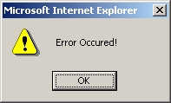
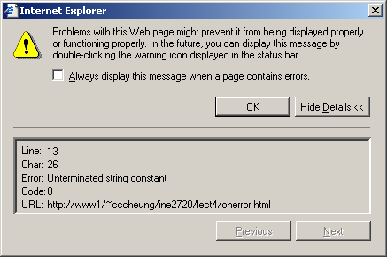
How to use “onError” event handler?
<html>
<head>
<title>onerror event handler example</title>
<script type="text/javascript">
function errorHandler(){
alert("Error Ourred!");
}
// JavaScript is casesensitive
// Don't write onerror!
window.onError = errorHandler;
</script>
</head>
<body>
<script type="text/javascript">
document.write("Hello there;
</script>
</body>
</html>

Slide 60
Document Object Model (DOM)
When a web page is loaded, the browser creates a Document Object Model of the page.
Representation of the current web page as a tree of Javascript objects
allows you to view/modify page elements in script code after page has loaded
client side = highly responsive interactions
browser-independent
allows progressive enhancement.

Slide 61
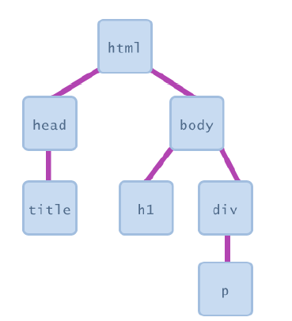
Contd…
most JS code manipulates elements on an HTML page
we can examine elements' state
e.g. see whether a box is checked
we can change state
e.g. insert some new text into a div
we can change styles
e.g. make a paragraph red

Slide 62
What is the DOM?
The DOM is a W3C (World Wide Web Consortium) standard.
The DOM defines a standard for accessing documents:
"The W3C Document Object Model (DOM) is a platform and language-neutral interface that allows programs and scripts to dynamically access and update the content, structure, and style of a document."
The W3C DOM standard is separated into 3 different parts:
Core DOM - standard model for all document types
XML DOM - standard model for XML documents
HTML DOM - standard model for HTML documents

Slide 63
What is the HTML DOM?
The HTML DOM is a standard object model and programming interface for HTML. It defines:
The HTML elements as objects
The properties of all HTML elements
The methods to access all HTML elements
The events for all HTML elements

Slide 64
JavaScript - HTML DOM Methods
HTML DOM methods are actions you can perform (on HTML Elements).
HTML DOM properties are values (of HTML Elements) that you can set or change.

Slide 65
The DOM Programming Interface
The HTML DOM can be accessed with JavaScript (and with other programming languages).
In the DOM, all HTML elements are defined as objects.
The programming interface is the properties and methods of each object.
A property is a value that you can get or set (like changing the content of an HTML element).
A method is an action you can do (like add or deleting an HTML element).

Slide 66
The getElementById Method
The most common way to access an HTML element is to use the id of the element.
In the example above the getElementById method used id="demo" to find the element.
The innerHTML Property
The easiest way to get the content of an element is by using the innerHTML property.
The innerHTML property is useful for getting or replacing the content of HTML elements.
The innerHTML property can be used to get or change any HTML element, including <html> and <body>.

Slide 67
Accessing elements: document.getElementById
var name = document.getElementById("id");
JS
<button onclick="changeText();">Click me!</button>
<span id="output">replace me</span>
<input id="textbox" type="text" /> HTML
function changeText() {
var span = document.getElementById("output");
var textBox = document.getElementById("textbox");
textbox.style.color = "red";
} JS
Notes:
span.innerHTML = textBox.value;

Slide 68
Contd…
document.getElementById returns the DOM object for an element with a given id
can change the text inside most elements by setting the innerHTML property
can change the text in form controls by setting the value property

Slide 69
Example
The following example changes the content (the innerHTML) of the <p> element with id="demo":
<html> <body> <p id="demo"></p> <script> document.getElementById("demo").innerHTML = "Hello World!"; </script> </body> </html>

Slide 70
The HTML DOM Document Object
The document object represents your web page.
If you want to access any element in an HTML page, you always start with accessing the document object.
Below are some examples of how you can use the document object to access and manipulate HTML.

Slide 71
JavaScript Objects
Real Life Objects, Properties, and Methods
In real life, a car is an object.
A car has properties like weight and color, and methods like start and stop:
ObjectProperties 1.car.name = Celerio 2.car.model = 2018 3.car.weight = 850kg 4.car.color = silky silver
Methods
1.car.start() 2.car.drive() 3.car.brake() 4.car.stop()

Slide 72
All cars have the same properties, but the property values differ from car to car.
All cars have the same methods, but the methods are performed at different times.
JavaScript Objects
You have already learned that JavaScript variables are containers for data values.
This code assigns a simple value (Celerio) to a variable named car:

Slide 73
<!DOCTYPE html>
<html>
<body>
<p>Creating a JavaScript Variable.</p>
<p id="demo"></p>
<script>
var car = “Celerio";
document.getElementById("demo").innerHTML = car;
</script>
</body>
</html>

Slide 74
Objects are variables too. But objects can contain many values.
This code assigns many values (Celerio, 2018, silky silver) to a variable named car:
<!DOCTYPE html>
<html>
<body>
<p>Creating a JavaScript Object.</p>
<p id="demo"></p>
<script>
var car = {type:“Celerio", model:“2018", color:“silky silver"};
document.getElementById("demo").innerHTML = car.type;
</script>
</body>
</html>
The values are written as name:value pairs (name and value separated by a colon).

Slide 75
Object Properties
The name:values pairs (in JavaScript objects) are called properties.
var person = {firstName:"John", lastName:"Doe", age:50, eyeColor:"blue"};
Object Methods:
Methods are actions that can be performed on objects.
Methods are stored in properties as function definitions.

Slide 76
Object Definition
You define (and create) a JavaScript object with an object literal:
Example
var person = {firstName:"John", lastName:"Doe", age:50, eyeColor:"blue"};
var person = { firstName:"John", lastName:"Doe", age:50, eyeColor:"blue" };

Slide 77
Accessing Object Properties
You can access object properties in two ways:
objectName.propertyName
Or
objectName["propertyName"]
Example1
person.lastName;
Example2
person["lastName"];

Slide 78
<!DOCTYPE html>
<html>
<body>
<p>
There are two different ways to access an object property:
</p>
<p>You can use person.property or person["property"].</p>
<p id="demo"></p>
<script>
var person = {
firstName: "John",
lastName : "Doe",
id : 5566
};
document.getElementById("demo").innerHTML =
person.firstName + " " + person.lastName;
</script>
</body>
</html>

Slide 79
<!DOCTYPE html>
<html>
<body>
<p>
There are two different ways to access an object property:
</p>
<p>You can use person.property or person["property"].</p>
<p id="demo"></p>
<script>
var person = {
firstName: "John",
lastName : "Doe",
id : 5566
};
document.getElementById("demo").innerHTML =
person["firstName"] + " " + person["lastName"];
</script>
</body>
</html>

Slide 80
Accessing Object Methods
You access an object method with the following syntax:
objectName.methodName()
Example
name = person.fullName();

Slide 81
<!DOCTYPE html>
<html>
<body>
<p>Creating and using an object method.</p>
<p>An object method is a function definition, stored as a property value.</p>
<p id="demo"></p>
<script>
var person = {
firstName: "John",
lastName : "Doe",
id : 5566,
fullName : function() {
return this.firstName + " " + this.lastName;
}
};
document.getElementById("demo").innerHTML = person.fullName();
</script>
</body>
</html>

Slide 82
The Document Object
A document is a web page that is being either displayed or created. The document has a number of properties that can be accessed by JavaScript programs and used to manipulate
the content of the page.
write or writeln
Html pages can be created on the fly using JavaScript. This is done by using the write or writeln methods of the document object.
Syntax:document.write (“String”); document.writeln (“String”);
In this document is object name and write () or writeln () are methods. Symbol period is used as connector between object name and method name. The difference between these two methods is carriage form feed character that is new line character automatically added into the document.
Exmaple: document.write(“<body>”); document.write(“<h1> Hello </h1>”);

Slide 83
bgcolor and fgcolor
These are used to set background and foreground(text) color to webpage. The methods accept either hexadecimal values or common names for colors.
Syntax: document.bgcolor=”#1f9de1”; document.fgcolor=“silver”;
anchors
The anchors property is an array of anchor names in the order in which they appear in the HTML Document. Anchors can be accessed like this:
Syntax:
document.anchors[0];
document.anchors[n-1];
Links
Another array holding all links in the order in which they were appeared on the Webpage
Forms
Another array, this one contains all of the HTML forms. By combining this array with the individual form objects each form item can be accessed.

Slide 84
The Window Object
The window object is used to create a new window and to control the properties of window.
Methods:
open(“URL”,”name”) : This method opens a new window which contains the document specified by URL and the new window is identified by its name.
close(): this shutdowns the current window.
Properties:
toolbar = [1|0] location= [1|0] menubar = [1|0] scrollbars = [1|0] status = [1|0] resizable = [1|0]
where as 1 means on and 0 means off
height=pixels, width=pixels : These properties can be used to set the window size.
The following code shows how to open a new window
newWin = open(“first.html”,”newWin”,”status=0,toolbar=0,width=100,height=100”);

Slide 85
Window object supports three types of message boxes.
Alert box Confirm box Prompt box
Alert box is used to display warning/error messages to user. It displays a text string with OK button.
Syntax: window. Alert (“Message”);

Slide 86
Confirm Box is useful when submitting form data. This displays a window containing message with two buttons: OK and Cancel. Selecting Cancel will abort the any pending action, while OK will let the action proceed.
Syntax
window.confirm(“String”);

Slide 87
Prompt box used for accepting data from user through keyboard. This displays simple window that contains a prompt and a text field in which user can enter data. This method has two parameters: a text string to be used as a prompt and a string to use as the default value. If you don‟t want to display a default then simply use an empty string. Syntax
Variable=window.prompt(“string”,”default value”);

Slide 88
The Form Object
Two aspects of the form can be manipulated through JavaScript. First, most commonly and probably most usefully, the data that is entered onto your form can be checked at submission. Second you can actually build forms through JavaScript.
Form object supports three events to validate the form
onClick = “method()”
This can be applied to all form elements. This event is triggered when the user clicks on the element.
onSubmit = “method()”
This event can only be triggered by form itself and occurs when a form is submitted.
onReset = “method()”
This event can only be triggered by form itself and occurs when a form is reset.

Slide 89
The browser Object
The browser is JavaScript object that can be used to know the details of browser. Some of the properties of the browser object is as follows:
Property | Description
navigator.appCodeName | It returns the internal name for the browser. For major browsers it is Mozilla
navigator.appName | It returns the public name of the browser – navigator or Internet Explorer
navigator.appVersion | It returns the version number, platform on which the browser is running.
navigator.userAgent | The strings appCodeName and appVersion concatenated together
navigator.plugins | An array containing details of all installed plug-ins
Navigator.mimeTypes | An array of all supported MIME Types

Slide 90
The Math Object
The Math object holds all mathematical functions and values. All the functions and attributes used in complex mathematics must be accessed via this object.
Syntax:
Math.methodname();
Math.value;

Slide 91
Method | Description | Example
Math.abs(x) | Returns the absolute value | Math.abs(-20) is 20
Math.ceil(x) | Returns the ceil value | Math.ceil(5.8) is 6 Math.ceil(2.2) is 3
Math.floor(x) | Returns the floor value | Math.floor(5.8) is 5 Math.floor(2.2) is 2
Math.round(x) | Returns the round value, nearest integer value | Math.round(5.8) is 6 Math.round(2.2) is 2
Math.trunc(x) | Removes the decimal places it returns only integer value | Math.trunc(5.8) is 5 Math.trunc(2.2) is 2
Math.max(x,y) | Returns the maximum value | Math.max(2,3) is 3 Math.max(5,2) is 5
Math.min(x,y) | Returns the minimum value | Math.min(2,3) is 2 Math.min(5,2) is 2
Math.sqrt(x) | Returns the square root of x | Math.sqrt(4) is 2

Slide 92
Math.pow(a,b) | This method will compute the a^{b} | Math.pow(2,4) is 16
Math.sin(x) | Returns the sine value of x | Math.sin(0.0) is 0.0
Math.cos(x) | Returns cosine value of x | Math.cos(0.0) is 1.0
Math.tan(x) | Returns tangent value of x | Math.tan(0.0) is 0
Math.exp(x) | Returns exponential value i.e e^{x} | Math.exp(0) is 1
Math.random(x) | Generates a random number in between 0 and 1 | Math.random()
Math.log(x) | Display logarithmic value | Math.log(2.7) is 1
Math.PI | Returns a ∏ value | a = Math.PI; a = 3.141592653589793

Slide 93
The Date Object
This object is used for obtaining the date and time. In JavaScript, dates and times represent in milliseconds since 1st January 1970 UTC. JavaScript supports two time zones: UTC and local. UTC is Universal Time, also known as Greenwich Mean Time(GMT), which is standard time throughout the world. Local time is the time on your System. A JavaScript Date represents date from -1,000,000,000 to -1,000,000,000 days relative to 01/01/1970.
Date Object Constructors:
new Date(); Constructs an empty date object.
new Date(“String”); Creates a Date object based upon the contents of a text string.
new Date(year, month, day[,hour, minute, second] ); Creates a Date object based upon the numerical values for the year, month and day.
var dt=new Date();
document.write(dt); // Fri Nov 11 2022 01:47:11 GMT+0530 (Sri Lanka Standard Time)

Slide 94
<!DOCTYPE html>
<html>
<body>
<p id="demo"></p>
<script>
document.getElementById("demo").innerHTML = Date();
</script>
</body>
</html>
output:
Fri Nov 11 2022 01:48:40 GMT+0530 (Sri Lanka Standard Time)

Slide 95
JavaScript Date Methods
Date methods let you get and set date values (years, months, days, hours, minutes, seconds, milliseconds)
Method | Description
getDate() | Get the day as a number (1-31)
getDay() | Get the weekday as a number (0-6)
getFullYear() | Get the four digit year (yyyy)
getHours() | Get the hour (0-23)
getMilliseconds() | Get the milliseconds (0-999)
getMinutes() | Get the minutes (0-59)
getMonth() | Get the month (0-11)

Slide 96
JavaScript Arrays
JavaScript arrays are used to store multiple values in a single variable.
Displaying Arrays
<!DOCTYPE html>
<html>
<body>
<p id="demo"></p>
<script>
var cars = ["Saab", "Volvo", "BMW"];
document.getElementById("demo").innerHTML = cars[0];
</script>
</body>
</html>

Slide 97
Creating an Array
Using an array literal is the easiest way to create a JavaScript Array.
Syntax:
var array-name = [item1, item2, ...];
Using the JavaScript Keyword new
The following example also creates an Array, and assigns values to it:
var cars = new Array("Saab", "Volvo", "BMW");
Access the Elements of an Array
You refer to an array element by referring to the index number.
var name = cars[0];
This statement modifies the first element in cars:
cars[0] = "Opel";
Can Have Different Objects in One Array
JavaScript variables can be objects. Arrays are special kinds of objects.
Because of this, you can have variables of different types in the same Array.
Example:
myArray[0] = Date.now; myArray[1] = myFunction; myArray[2] = myCars;

Slide 98
Arrays are Objects
Arrays are a special type of objects. The typeof operator in JavaScript returns "object" for arrays.
But, JavaScript arrays are best described as arrays.
Arrays use numbers to access its "elements". In this example, person[0] returns John:
Array: var person = ["John", "Doe", 46];
Objects use names to access its "members". In this example, person.firstName returns John:
Object: var person = {firstName:"John", lastName:"Doe“, age:46};
Array Properties and Methods
The real strength of JavaScript arrays are the built-in array properties and methods:
Examples
var x = cars.length; // The length property returns the number of elements in cars var y = cars.sort(); // The sort() method sort cars in alphabetical order

Slide 99
Note:
var points = new Array(); // Bad
var points = []; // Good
When to Use Arrays? When to use Objects?
JavaScript does not support associative arrays.
You should use objects when you want the element names to be strings.
You should use arrays when you want the element names to be sequential numbers.

Slide 100
Array Object Methods
Method | Description
concat() | Joins two or more arrays, and returns a copy of the joined arrays
indexOf() | Search the array for an element and returns its position
join() | Joins all elements of an array into a string
lastIndexOf() | Search the array for an element, starting at the end, and returns its position
pop() | Removes the last element of an array, and returns that element
push() | Adds new elements to the end of an array, and returns the new length
reverse() | Reverses the order of the elements in an array
shift() | Removes the first element of an array, and returns that element
slice() | Selects a part of an array, and returns the new array
sort() | Sorts the elements of an array
splice() | Adds/Removes elements from an array
toString() | Converts an array to a string, and returns the result
unshift() | Adds new elements to the beginning of an array, and returns the new length
valueOf() | Returns the primitive value of an array

Slide 101
Concat():Joins two or more arrays, and returns a copy of the joined arrays.
Syntax: array.concat(array1,array2…..);
Ex:
var hege = ["Cecilie", "Lone"]; var stale = ["Emil", "Tobias", "Linus"]; var kai = ["Robin"]; var children = hege.concat(stale,kai);
indexOf():this method searches the array for the specified item, and returns its position.
The search will start at the specified position, or at the beginning if no start position is specified, and end the search at the end of the array.
Returns -1 if the item is not found.
If the item is present more than once, the indexOf method returns the position of the first occurrence.
Syntax: array.indexOf(item);
Ex: var fruits=[“Banana”,Orange”,”Apple”,”Mango”];
var x=fruits.indexOf(“Apple”);
Here the value of x is:2 i.e. Apple is at position 2.

Slide 102
Join():The join() method joins the elements of an array into a string, and returns the string.
The elements will be separated by a specified separator. The default separator is comma (,).
Syntax: array.join();
Ex: var fruits=[“Banana” Orange”,”Apple”,”Mango”];
var x=fruits.join();
the result of x will be Banana,Orange,Apple,Mango.
Slice(): The slice() method returns the selected elements in an array, as a new array object.
The slice() method selects the elements starting at the given start argument, and ends at, but does not include, the given end argument.
Syntax: array.slice (start, end);
Ex: var fruits=[“Banana”,Orange”,”Apple”,”Mango”];
var x=fruits.slice(1,3);
the result of x will be [Orange,Apple];
Splice(): The splice() method adds/removes items to/from an array, and returns the removed item(s).
Syntax: array.splice(index,howmany,item1,item2….);
Ex: var fruits=[“Banana”,Orange”,”Apple”,”Mango”];
fruits.splice(2,1,”Lemon”,”Kiwi”);
the result of fruits will be [Banana,Orange,Lemon,Kiwi,Mango]

Slide 103
Arrays Operations and Properties
Declaring new empty array:
Declaring an array holding few elements:
Appending an element / getting the last element:
Reading the number of elements (array length):
Finding element's index in the array:
var arr = new Array();
var arr = [1, 2, 3, 4, 5];
arr.push(3);
var element = arr.pop();
arr.length;
arr.indexOf(1);

Slide 104
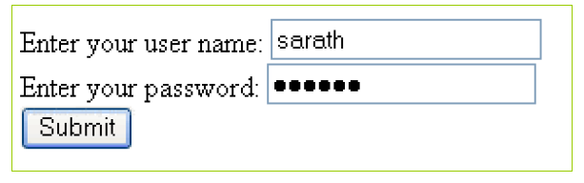
Form Validation Example
A form to get user name and password. Validation required to check
has the user left required fields empty
has the user entered text in correct length

Slide 105
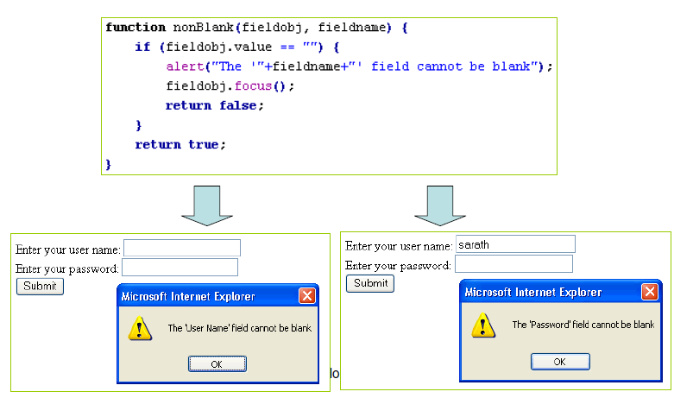
Checking the Field is Not Blank
Notes:
function nonBlank(fieldobj,fieldname) {
if (fieldobj.value == "") {
alert("The'"+ fieldname +"' field cannot be blank");
fieldobj.focus();
}
}

Slide 106
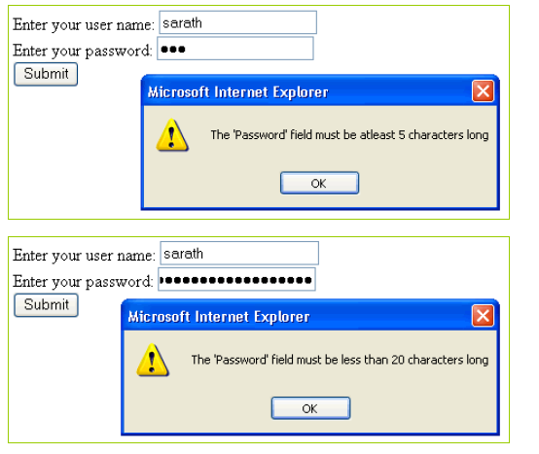
Checking the Field is in Correct Length

Slide 107
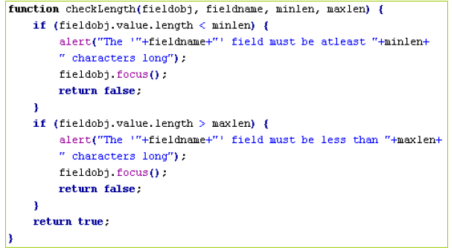
Checking the Field is in Correct Length

Slide 108
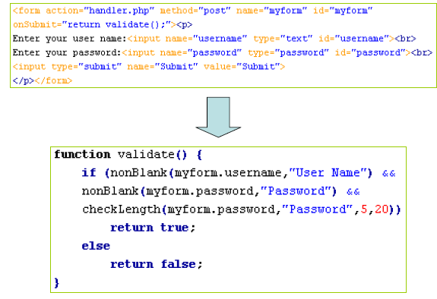
Main Form Handler

Slide 109
Form validation example contd…
<html>
<head>
<script language="javascript">
function validate()
{
var x=f1.t1.value;
var y=f1.t2.value;
var re=/\d|\W|_/g;
if(x==''||y=='')
window.alert("Enter both user id and password");
else if(x.length<6||y.length<6)
window.alert("both user id and password should greater than or equal to 6");
else if((re.test(x)))
window.alert("user name show3uld be alphabets");
else
window.alert("welcome"+" Mr."+x);
}

Slide 110
</script>
</head>
<body bgcolor="green">
<form name="f1">
<center>
User Name<input type="text" name="t1"><br><br>
Password <input type="password" name="t2"><br><br>
<input type="submit" value="submit" onClick=validate()>
<input type="reset" value="reset">
</center>
</form>
</body>
</html>

Slide 111
DYNAMIC HTML
DHTML is combination of HTML, CSS and JavaScript. It gives pleasant appearance to web page.
Difference between HTML and DHTML
HTML | DHTML
HTML is used to create static web pages. | DHTML is used to create dynamic web pages.
HTML is consists of simple html tags. | DHTML is made up of HTML tags+cascading style sheets+javascript.
Creation of html web pages is simplest but less interactive. | Creation of DHTML is complex but more interactive.

Slide 112
Contd…
Dynamic HTML, or DHTML, is for a collection of technologies used together to create
interactive and animated by using a combination of a static markup language (such as HTML), a client-side scripting language (such as JavaScript), a presentation definition language (such as CSS), and the Document Object Model.

Slide 113
Uses
DHTML allows authors to add effects to their pages that are otherwise difficult to achieve.
For example, DHTML allows the page author to:
Animate text and images in their document, independently moving each element from any starting point to any ending point, following a predetermined path or one chosen by the user.
· Embed a ticker that automatically refreshes its content with the latest news, stock quotes, or other data.
· Use a form to capture user input, and then process and respond to that data without having to send data back to the server.
· Include rollover buttons or drop-down menus.

